Slide 1
About this PowerPoint
We created this overview PowerPoint for schools, community-based organizations, and partners to present about DiscoverU. Please feel free to edit this presentation to meet the needs of your audience and add any slides that you want to show what you are doing for DiscoverU!

Slide 2
October 17-21, 2016
College & Career Exploration — for all students, together.
#DiscoverUWA

Slide 3
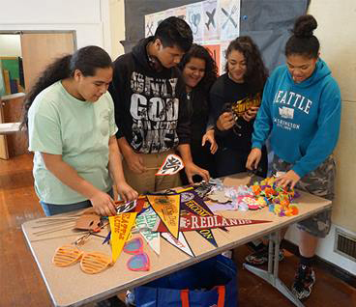
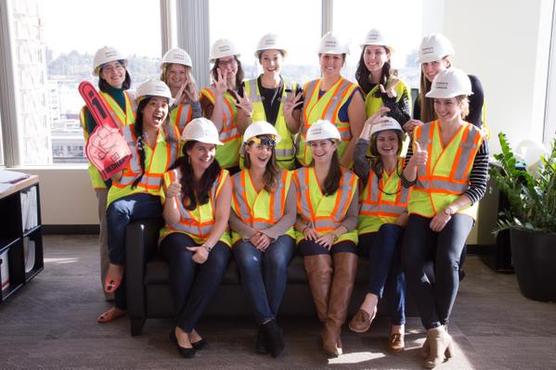
What is DiscoverU?
DiscoverU is an exciting week for our community to come together and support all students in exploring career and college options. Through fun activities, both in school and in the community, students throughout Seattle and South King County will have opportunities to explore their futures.
#DiscoverUWA

Slide 4
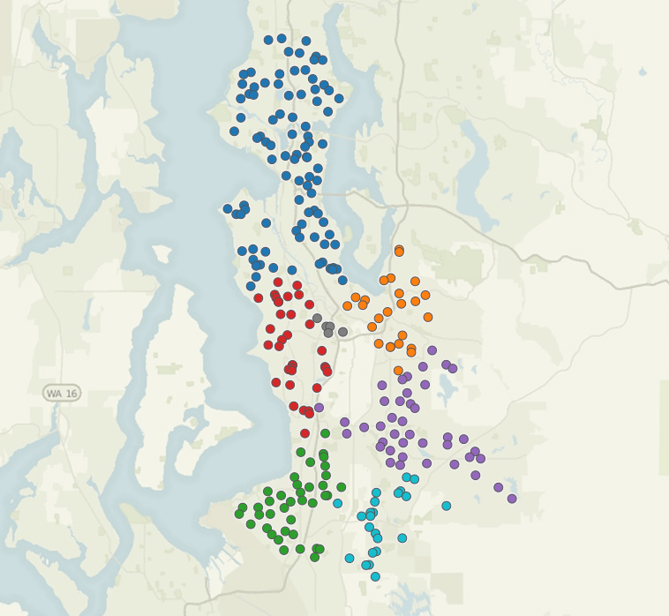
Where is DiscoverU?
Seattle & South King County
Auburn
Federal Way
Highline
Kent
Renton
Seattle
Tukwila
#DiscoverUWA

Slide 5
Why DiscoverU?
DiscoverU is an effort to help build a “beyond high school” culture
Research finds that attending a school with a college-going climate is one of the most important predictors of students attending college
When students think about and plan for their futures, they do better in school
Currently too few students are exposed to career awareness activities
Research shows young women and students of color often limit their career choices early
Middle school is a time when kids are forming ideas about careers, however they often lack awareness about careers or have unrealistic ideas about the world of work
#DiscoverUWA

Slide 6
The DiscoverU Effect
DiscoverU provides schools and organizations the opportunity to carry out many of their existing career and college lessons, but with the added boost of:
Doing them at the same time–So students in all grades are exploring career and college together
Using the same language–So that the importance of education beyond high school is being reinforced with students and families across all districts
Bringing more stakeholders into the mix–So that the broader community, from mayors to libraries, shares a commitment to student success beyond high school
#DiscoverUWA

Slide 7
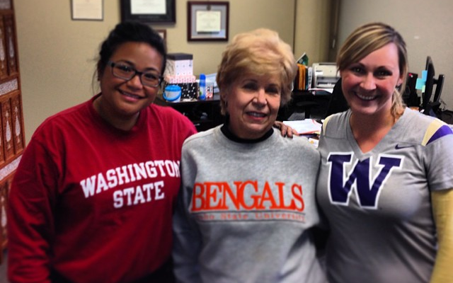
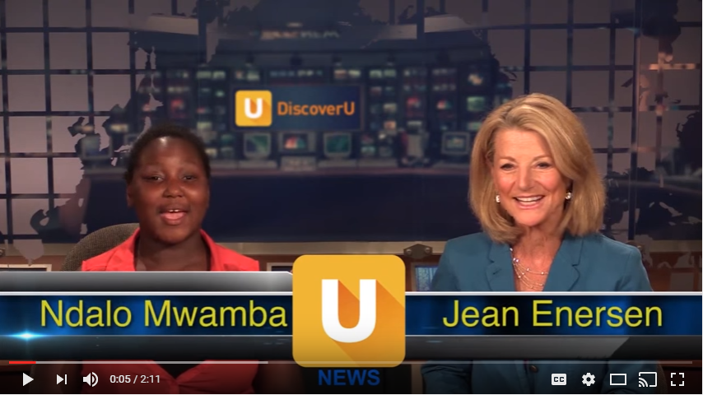
History
October 17, 2013
First DiscoverU Day
October 13-17, 2014
DiscoverU Becomes a Full Week
October 12-16, 2015
DiscoverU Continues to Grow
October 17-21, 2016
4th Annual DiscoverU Week
For more DiscoverU history, visit our website: www.discoveruwa.org
#DiscoverUWA

Slide 8
Goals
Provide all students pre-kindergarten to 12th grade the opportunity to explore their interests and learn about college pathways and career options
Expose middle and high school students to the career opportunities in our region and help them understand the education and skills needed to get there
Engage the broader community in supporting college and career awareness and exploration for all students
#DiscoverUWA

Slide 9
DiscoverU In Action
Teachers, school staff and community partners lead fun and engaging career and college exploration activities
Find activity ideas on www.discoveruwa.org
Post pictures on Facebook and Twitter to #DiscoverUWA
Science, technology, engineering and math focused career lessons and family engagement activities coming soon to the website
Not sure where to start—align your activities to our DiscoverU activity days
#DiscoverUWA

Slide 10
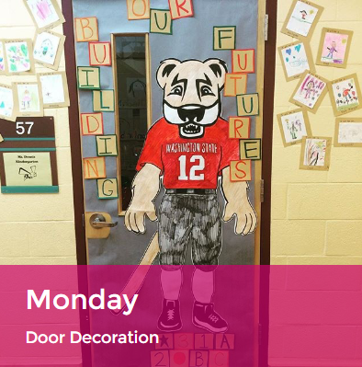
DiscoverU Activity Days
Creating a “beyond high school” culture starts with the atmosphere surrounding our students. Put up pathway posters, rock those collegiate mascots and encourage students to get involved in decorating.
#DiscoverUWA

Slide 11
DiscoverU Activity Days
Talking to students about the education and jobs that led to your career is an easy way to get them thinking about the possibilities in their futures. Tell your pathway story and consider inviting alumni, families or guests to share too.
#DiscoverUWA

Slide 12
DiscoverU Activity Days
Show your school pride by wearing your college gear! Don’t forget to emphasize all postsecondary pathways, technical, 2-year and 4-year (T-2-4).
#DiscoverUWA

Slide 13
DiscoverU Activity Days
Has a student ever asked you, “Why do I need to know this?” Take time on this day to connect classroom content to careers in our economy.
#DiscoverUWA

Slide 14
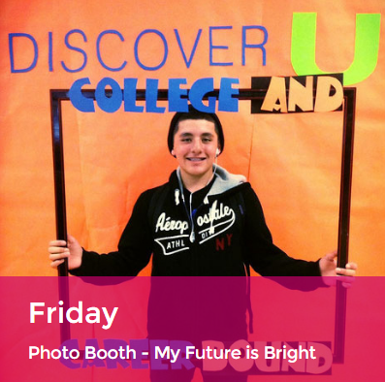
DiscoverU Activity Days
This is all about fun and neon! Schools and community-based organizations will receive a swag kit to set up their own photo booth.
#DiscoverUWA

Slide 15
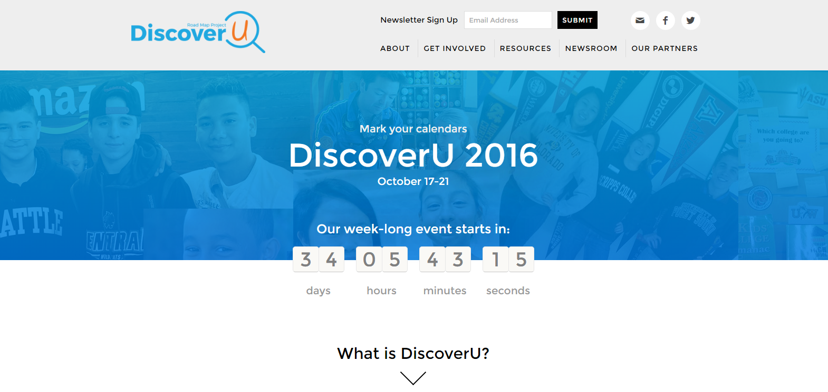
Resources
www.discoveruwa.org
#DiscoverUWA

Slide 16
Challenge Seattle Partnership
Challenge Seattle is a private sector initiative led by CEOs from 17 companies based in the Seattle area
#DiscoverUWA

Slide 17
Challenge Seattle & DiscoverU Partnership
Challenge Seattle is supporting the expansion of DiscoverU by hosting:
CEO and employee career presentations in classrooms
Worksite tours during the school day
These commitments will continue throughout the school year and expand to reach more students.
Challenge Seattle companies want to spread the message that they want to hire students growing up in our region.
#DiscoverUWA

Slide 18
More Information—Sign Up!
For more information about DiscoverU visit our website: www.discoveruwa.org
You can complete our sign up form to:
Download the DiscoverU toolkit
Receive the weekly newsletter
Add your logo to the participating partners
We want everyone to get involved in DiscoverU!
#DiscoverUWA

Slide 19
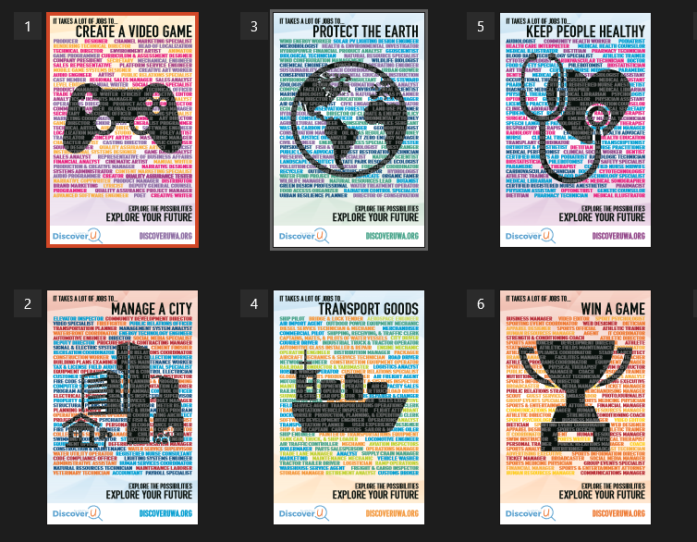
Swag for Schools & Community Partners
Posters
Stickers
“My Future is Bright” Photo Booth Kits
Sunglasses
Pennants
Signs
#DiscoverUWA

Slide 20
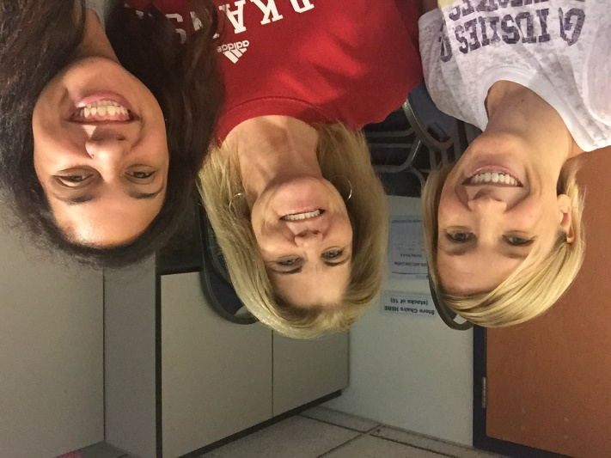
Contact Us
Kirsten “Avery” Avery
College and Career Success Director
kavery@ccedresults.org
Alejandra Pérez
College and Career Success Coordinator
aperez@ccedresults.org
www.discoveruwa.org
#DiscoverUWA

Slide 21
THANK YOU for supporting our students in exploring career and college options!
#DiscoverUWA

Slide 22
WARM UP ACTIVITY EXAMPLES 1. Career and College Exploragories 2. My First Career
Note: Feel free to use these as ideas when you would like to do a fun warm-up activity to introduce DiscoverU to your audience.
#DiscoverUWA

Slide 23
Career and College Exploragories
Instructions
3-minutes
Quickly write down your most creative answers that start with the assigned letter
Letter | College | Career | College Major | Company in PNW | Score
P
T
Letter | College | Career | College Major | Company in PNW | Score
P | Pitzer College | Pathologist | Political Science | PATH
T | Temple University | Truck Driver | Theology | Theo Chocolate
#DiscoverUWA
Notes:
Facilitator Instructions:
This activity will help your audience start thinking about career and college exploration for students. It’s a fun game and is an example of the types of activities you can do with students. This activity borrows from the games Scattergories and Basta.
To prepare for the game, you will need to make copies of the table in slide 24 for each person. Two copies of the table will fit on an 8.5”x11” piece of paper horizontally. If you would like a Word version that is printable, please email aperez@ccedresults.org. This game works especially well when people are seated in groups at tables because it makes scoring easier when there aren’t too many people.
Hand out copies of the game to each person, but make sure they keep it face down so they don’t start brainstorming early! Once everyone has a copy of the game, you can begin to deliver the instructions on the slide. Each person will have 3-minutes to quickly write down their answers to the categories using the assigned letters. Click the space bar to bring up the example that is animated. For example, if the letter is “P” and they are trying to come up with a “college,” you might write Pitzer College or Penn State. Keep in mind, you are trying to be as creative as possible and identify answers at your table that no one else will pick. When we score the game, you will not receive any points for repeated answers.
Make sure to ask if everyone understands or if they still have questions. Then set your timer and tell everyone to GO!

Slide 24
Career and College Exploragories
Scoring
1 point for each answer
Repeated answers = 0
Blanks = 0
Letter | College | Career | College Major | Company in PNW | Score
T | Tennessee State University | Therapist | Theology | T-Mobile | 3
Letter | College | Career | College Major | Company in PNW | Score
T | Temple University | Truck Driver | Theology | Theo Chocolate | 3
Letter | College | Career | College Major | Company in PNW | Score
T | Tacoma Community College |  | Theater |  | 2
#DiscoverUWA
Notes:
Facilitator Instructions:
When you go to do scoring, have people compete against people at their table. Each person will share their answer within a letter/category. For example, they share the answer for the College that starts with “T” they wrote down: TSU, Temple, TCC. Since there are no repeats, everyone gets a point. When there is a shared answer, like “Theology” above, those two players cross it out and do not receive a point. Blanks also do not receive points.
Have everyone total their scores and see who the winner at each table is and who has the highest answer in the room. Try to have a prize for either table winners or the highest score in the room!
By show of hands, ask if anyone learned about a college, career, major or company they hadn’t heard of before? Part of exploring is learning from the people around us!

Slide 25
Career and College Exploragories
Blank Game Board
Career and College Exploragories
Letter | College | Career | College Major | Company in PNW | Score
 |  |  |  | Total Score:
#DiscoverUWA
Notes:
Facilitator Instructions:

Slide 26
My First Career
Instructions
Brainstorm the first career or job that you wanted to have as a kid
On a post-it note, write:
1. Career/Job
2. What most influenced you to decide on that career
Postal carrier
Family friend
#DiscoverUWA
Notes:
Materials:
Post-its
Large paper or white board with “Career Connected Learning Ecosystem” boxes drawn, slide 26.
Facilitator Instructions:
This activity is to help your audience think about what influenced their own awareness of careers and what influences their student’s exploration. Each person is asked to brainstorm the first career or job that they wanted to be as a kid and how they knew about that career/job. They will then write that on a post-it note.

Slide 27
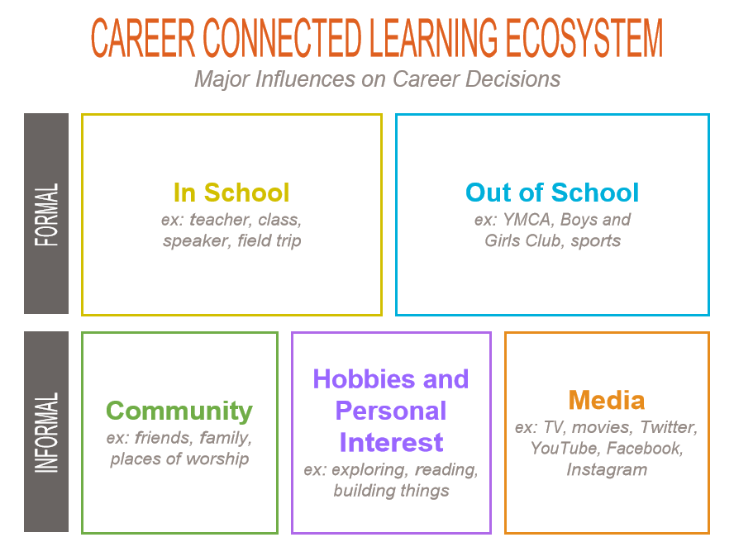
My First Career
Postal carrier
Family friend
Activity provided by Washington STEM
#DiscoverUWA
Notes:
Facilitator Instructions:
On a large piece of paper the boxes of the “Career Connected Learning Ecosystem” above should be drawn. Participants are then asked to share what is on their post-it and place it on the corresponding category for what influenced their career interest. Alternatively, people can already have placed their post-its and the facilitator has people go around the room and share.
Once everyone has shared, have some discussion about what you see. Are there most common categories? What are people’s observations about how they learned about careers? Generally, we find that people that participate in this activity learn about their careers in informal settings, especially from family. This shows us that not only is family and community engagement in our career work, but that more opportunities during school could be helpful to students with less access to career exposure opportunities.
Thank everyone for sharing.

